Slide 1
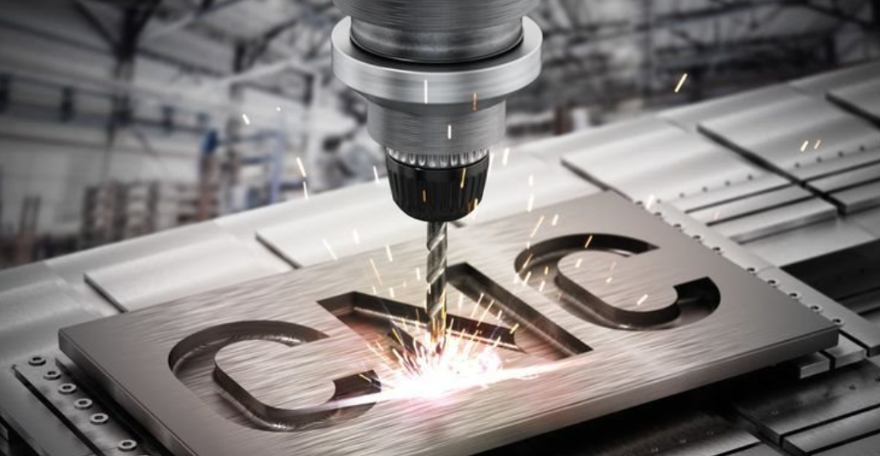
Injection molds maintenance
Project 742_051
Key Intent
Repair of the mold
Located in Gotmar - BG0200P079
Inv Nu: SEP0431
General state of the mold: Bad
Techno overview
Change of inserts due to modification of the parts requested by SEP
Overview & key messages on current situation
Topic: Capacity
Improving old tools with expired life Y4
Modification according to SEP requirements
Quality improvement
Securing capacity according to the SPS rule
Lower cost of the manufactured product
Ensure stable deliveries and quality of AAV30014A for Plovdiv/Ales Plants.
Yearly Forecast = 12M sets.
Reduce NPT in Plovdiv Assembly Lines
Reduce Scrap Rate in Plovdiv Assembly process.
Finance
Required Capex | 11k€
Required Opex
TOTAL | 11k€
Future situation (Gains)
Modified parts accordingg to SEP request and more capacity needed to cover new forecast of 12mil vs 7mil in the past
Comments: …
Incurde when?
Initial Planning
2025-09
BCI preparation
2025-09
BCI Validation
Risks in case NO GO
2025-09
PO
Stop delivery of the AAV30014A BGBFBBV49947A BGBFBBV49944A
2025-11
Realization stage
2026-01
Finish of the project

